Slide 1




Session 20
SQL Server 2016
PolyBase, Query Store, and Stretch Database

Slide 2
Objectives
SQL Server
2016
Describe PolyBase
Explain features and advantages of PolyBase
Define and describe Query Store
Explain how to dynamically stretch warm and cold transactional data from SQL Server to Azure
Describe how to tune workload performance with Query Store

Slide 3










Understanding Polybase 1-2
SQL Server 2016
Increase in storage of data in Hadoop or Azure creates the need for applications to connect with them and skills to work with this data.
Polybase is a built-in feature in SQL Server 2016.
Connect from SQL Server to Hadoop or Azure Storage with T- SQL.
No need for any importing tools or in-depth knowledge of any other Hadoop concepts like MapReduce or Hive.
HADOOP
QUERY TO HADOOP OR AZURE
SQL SERVER
T-SQL
QUERIES
AZURE BLOB
STORAGE

Slide 4
Understanding Polybase 2-2
SQL Server 2016
Simplifies access to big data on Hadoop and Azure Blob Storage using simple T-SQL
Enables import and export of data between SQL Server and Hadoop or Azure
Blob Storage
Integrates with Business Intelligence tools to generate reports
Improves performance by processing data on Hadoop or where the data resides
Integrates with different systems to work with data, eliminating the need to customize any existing applications
Incorporates external data into the database schema, thereby keeping the
operations transparent to the end user and querying application

Slide 5






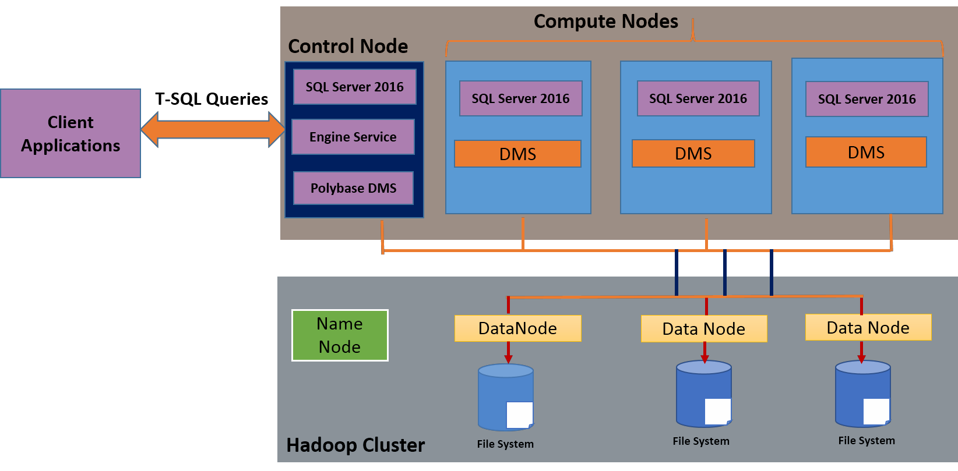
Polybase Architecture
SQL Server
2016
Similar to Hadoop’s Name Node/Job tracker and SQL Server instance acts as the Control Node
Runs the Polybase Engine Service
Manages queries between applications and external data sources
CONTROL NODE
Similar to Hadoop’s Data Node/Task tracker
Runs Polybase Data Movement Service
Brings data temporarily to SQL Server to handle the parallel query executions
COMPUTER
NODE

Slide 6
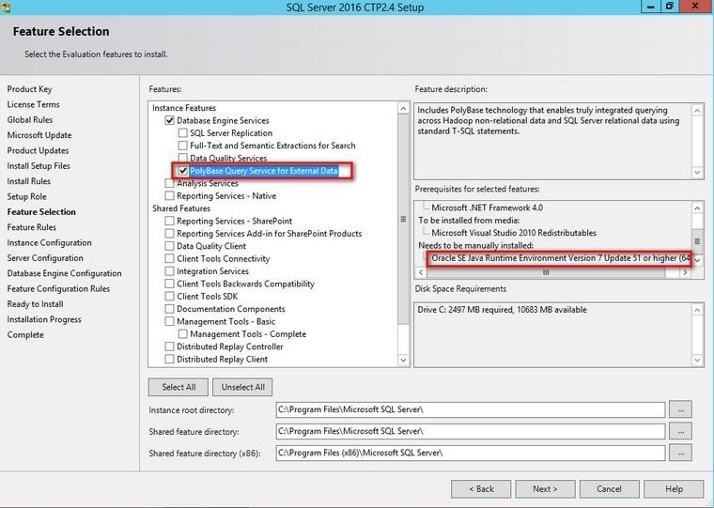


Installing and Setting up Polybase 1-2
SQL Server
2016
Select Polybase feature during SQL Server set up
Ensure JRE installation
Configure interaction with Hadoop or Azure Storage
EXEC sp_configure ‚ hadoop connectivity, 5; GO
RECONFIGURE; GO
Create a data source object that defines the connection to the external data source:
CREATE EXTERNAL DATA SOURCE HDP WITH
( TYPE=’HADOOP’
Location=’hdfs://sandbox.hortonworks.com:80
20’;

Slide 7


Installing and Setting up Polybase 2-2
SQL Server
2016
Define a file format object to specify the format of external data by using the statement: CREATE EXTERNAL FILE FORMAT.
CREATE EXTERNAL FILE FORMAT TSV
WITH (
FORMAT_TYPE = DELIMITEDTEXT, FORMAT_OPTIONS (
FIELD_TERMINATOR = , \T’, DATE_FORMAT = , MM/DD/YYYY’
Create external tables using the CREATE EXTERNAL TABLE statement to facilitate a schema-based structure.
CREATE EXTERNAL TABLE sample_1 (
Code nvarchar (255),
Description nvarchar (255),
Total_emp int,
Salary nvarchar (255)
) WITH (
LOCATION = ‘/APPS/HIVE/WAREHOUSE/SAMPLE_07’, DATA_SOURCE = HDP2,
FILE_FORMAT=TSV,
REJECT_TYPE=value, REJECT_VALUE=0
)
Verify creation of External Resources and External tables folders.

Slide 8
Query Store
SQL Server
2016
Is a built-in tool in SQL Server 2016 to aid performance tuning
Maintains a complete history of execution plans of all queries including all the changes to the plans
Monitors and stores the performance information of each execution plan over a period
Analyzes information regarding query execution times, memory consumption
Identifies and alerts about the plans causing performance issues
Facilitates quick ‘roll-back’ to any old plan and thus helps to troubleshoot performance issues

Slide 9
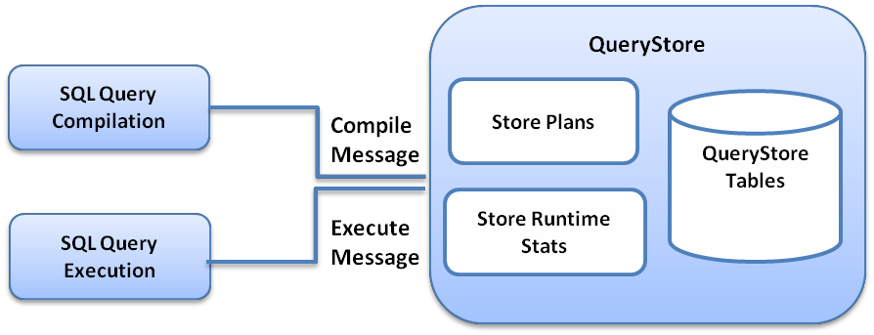
Query Store Architecture
SQL Server
2016
Each query compilation or execution by SQL Server
sends a message to the Query store.
Compilation and execution information is first stored in cache and then on disk.
INTERVAL_LENGTH_MINUTES parameter and the DATA_FLUSH_INTERVAL_SECONDS parameter specified during Query Store configuration determine the frequency of cache storage and flush to disk.

Slide 10
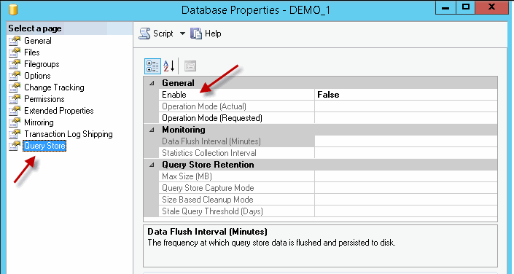

Enabling Query Store
SQL Server
2016
Two methods to enable the Query Store on a database:
Using GUI inside SQL Server Management Studio (SSMS)
Using T-SQL:
ALTER DATABASE [DEMO] SET QUERY_STORE = ON
GO

Slide 11
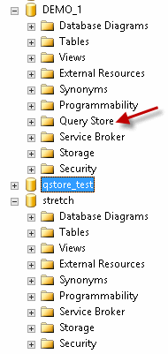
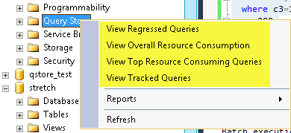

Viewing Query Information
SQL Server
2016
To view information about queries right-click or expand the Query Store container and select the required options.

Slide 12
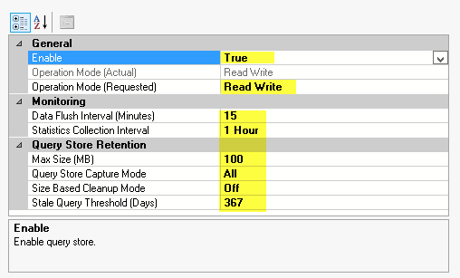

Configuring Query Store
SQL Server
2016
Setup parameters using SSMS
Setup parameters using T-SQL
ALTER DATABASE (DEMO_1)
SET QUERY_STORE (OPERATION_MODE = READ ONLY,
CLEANUP_POLICY = STALE_QUERY_THRESHOLD_DAYS = 367), DATA_FLUSH_INTERVAL_SECONDS = 900,
INTERVAL_LENGTH_MINUTES = 60,
MAX_STORAGE_SIZE_MB = 100, QUERY_CAPTURE_MODE = AUTO, SIZE_BASED_CLEANUP_MODE = AUTO)
GO

Slide 13
Applications of Query Store
SQL Server
2016
Identify and rectify performance impact due to plan changes
Alter queries to ensure optimal resource usage
Analyze and allocate resources based on query frequency
Troubleshoot performance issues due to upgrades or new versions of applications

Slide 14
Stretch Database
SQL Server
2016
Enables storage of a part of a database in the cloud.
Facilitates secure migration of tables and data to the cloud.
Allows to access and query the data on the cloud at any time, without any changes to existing applications or queries.
Reduces storage needs of on-premise data by using the vast storage capacity of the cloud.
Reduces costs as cloud-storage is economical.

Slide 15
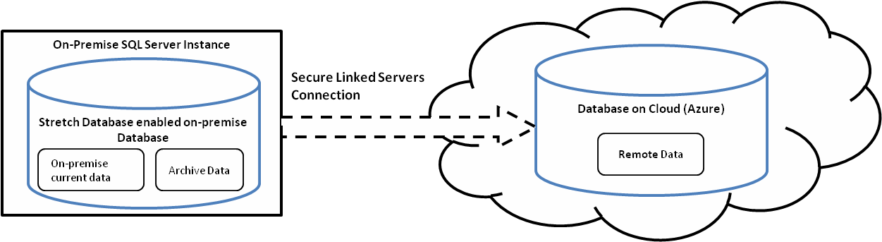
Stretch Database Architecture
SQL Server
2016
A secure linked server definition establishes a connection to the remote or cloud database.
When Stretch Database is enabled on a table, the resources on cloud are prepared and if migration is enabled, eligible data is migrated to the cloud database.

Slide 16
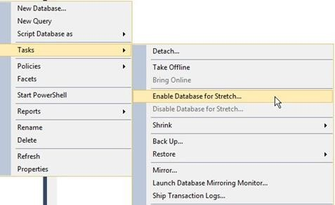


Setting up Stretch Database
SQL Server
2016
Create an Azure account.
Enable Stretch Database.
EXEC sys.sp_configure N'remote data archive', '1';
RECONFIGURE;
GO
Select the database and the table that needs to be ‘Stretched’ to the cloud.
On the Object Explorer, right-click the database, select Tasks and then select the Enable Database for Stretch option.
Complete the actions on the wizard to create secure link.
Enable Remote Data Archive on the table.
USE [StretchDemo]; GO
ALTER TABLE [StretchSampleTable] ENABLE REMOTE_DATA_ARCHIVE WITH (MIGRATION_STATE = ON );
GO
Query the Dynamic Management View (DMV) sys.dm_db_rda_migration_status to confirm and monitor data migration.

Slide 17
Stretch Database Limitations
SQL Server
2016
Stretch Database does not support:
Tables that are replicated
Memory-optimized tables
Tables that contain FILESTREAM data
Tables that use Change Tracking or Change Data
Tables with columns that are always-encrypted data
Tables with data-types such as XML, filestream, and sql_variant
It also does not support some features such as:
Foreign key constraints on a table
ColumnStore Indexes and full-text indexes
UPDATE statements and DELETE statements and the CREATE INDEX and ALTER INDEX operations

Slide 18
Summary
SQL Server
2016
The PolyBase feature provides seamless integration with external data sources, such as Hadoop or Azure Blob Storage.
PolyBase eliminates the need to specialized skills on Hadoop internals by enabling query-runs on external data sources with simple Transact-SQL commands.
Query Store is a built-in tool to improve performance by maintaining historical information of every query and execution plan.
Query Store tracks the performance of queries and triggers alerts on poorly performing plans.
Stretch Database is a feature in SQL Server 2016 that enables stretching
some part of a database to the Azure cloud, thereby lowering long-term storage costs as well as maintenance efforts.
With Stretch Database, archive data as well as any current data can be migrated to the cloud securely and also accessed as easily as accessing local data at any time.

